Slide 1



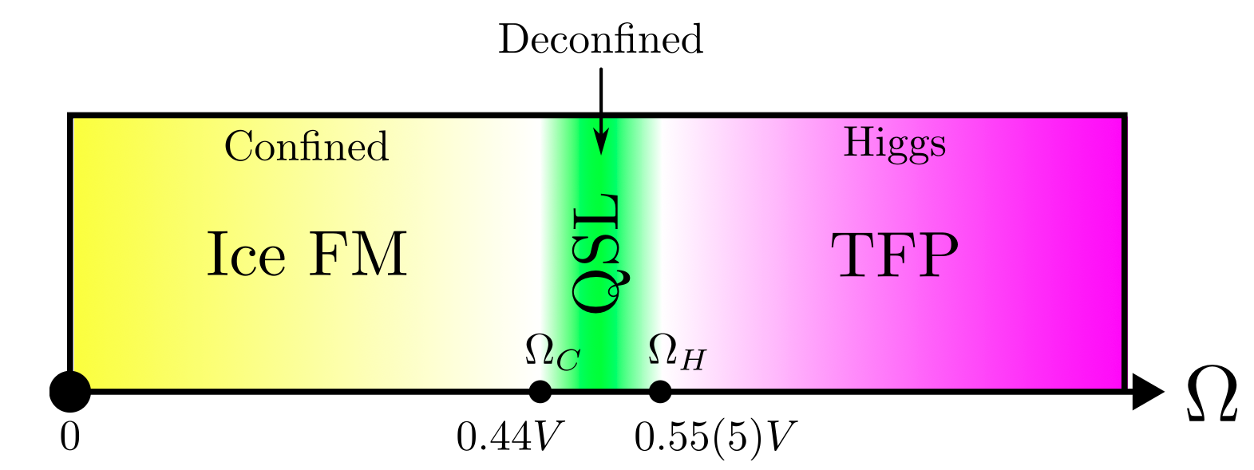
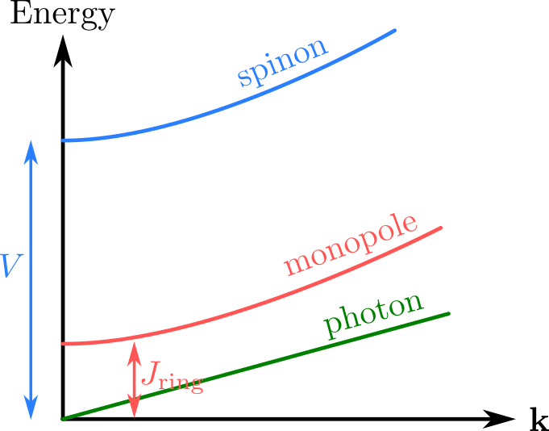
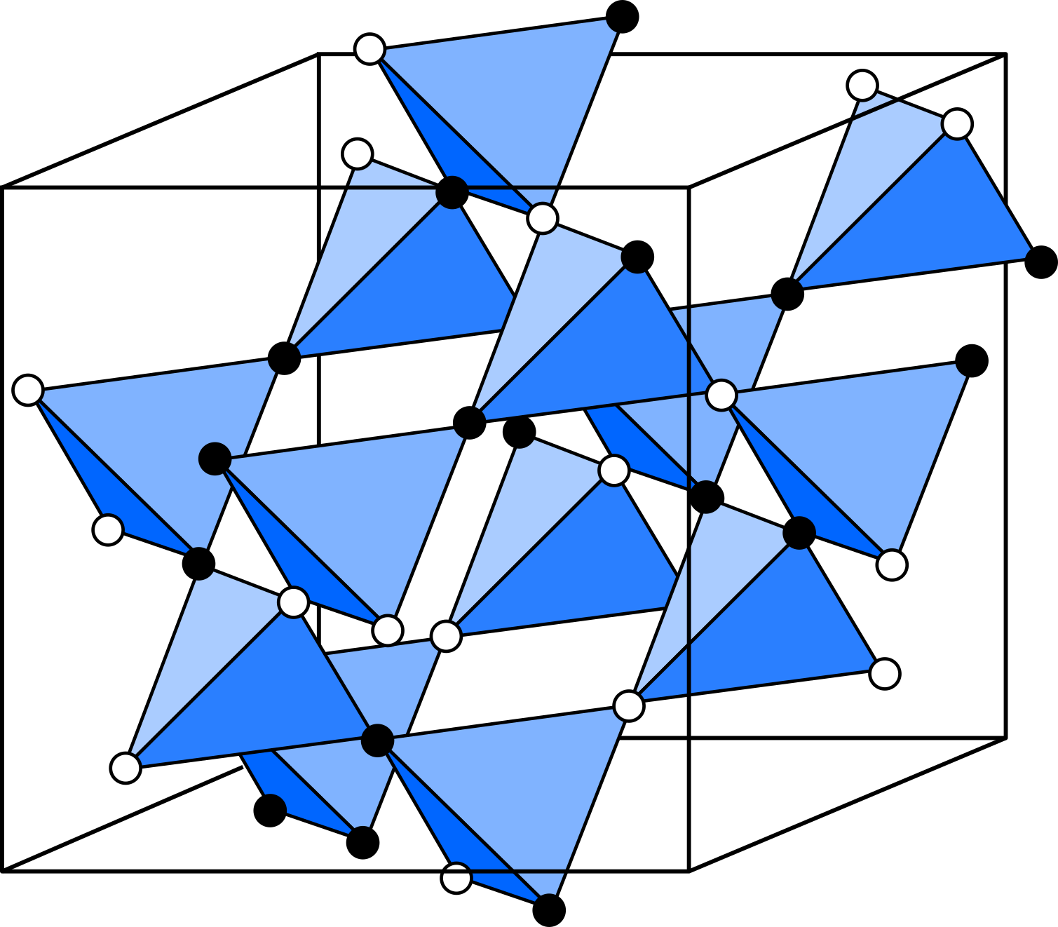

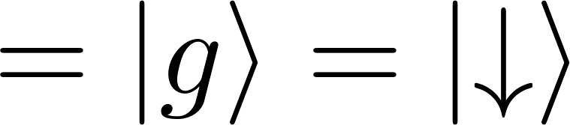

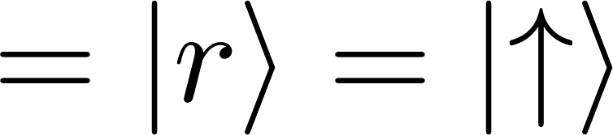
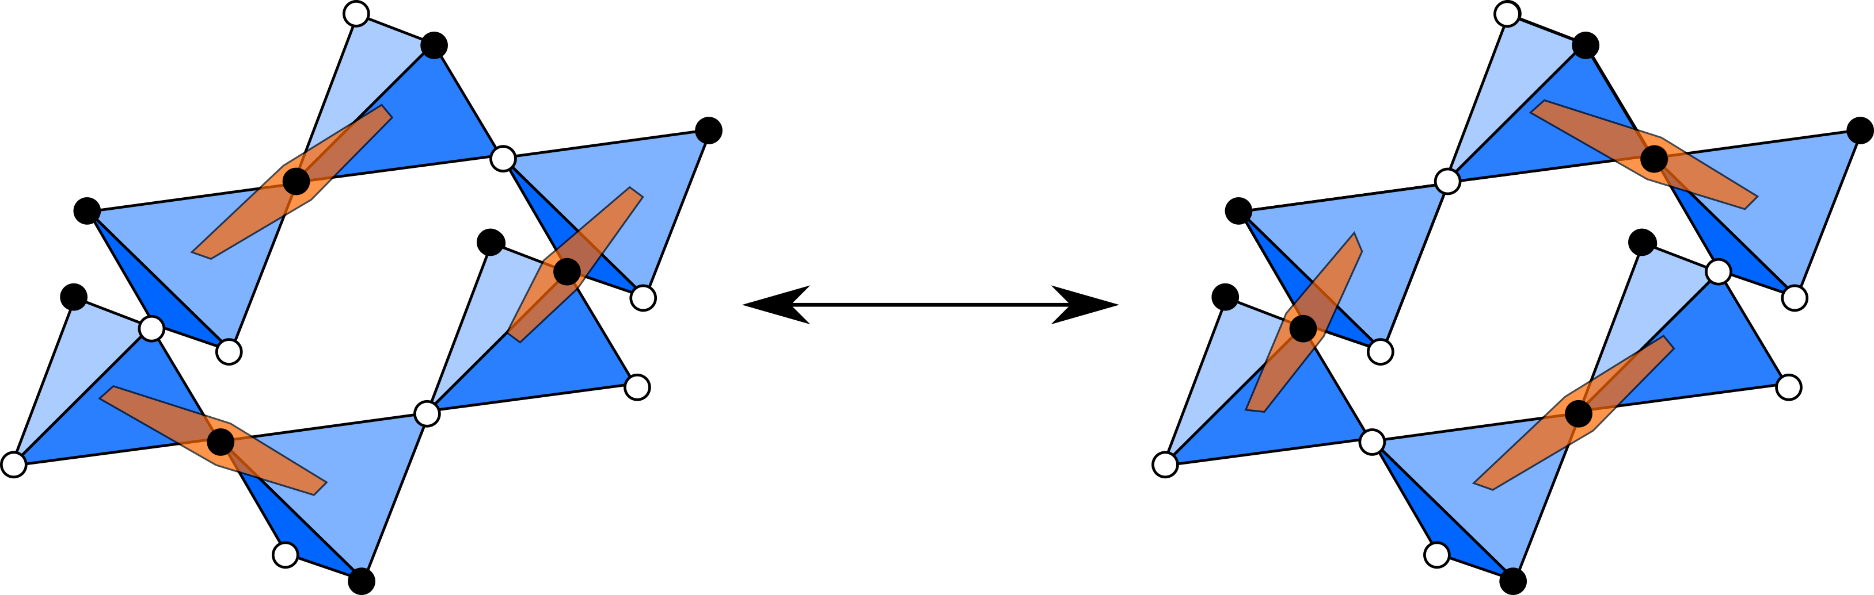
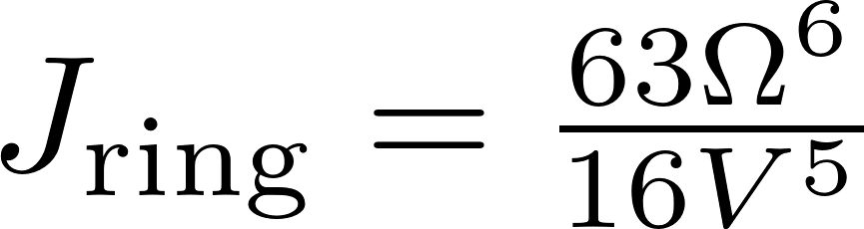
Quantum spin ice in three-dimensional Rydberg atom arrays
Jeet Shah, Gautam Nambiar, Alexey V. Gorshkov, and Victor Galitski
arXiv:2301.04657
Background & Motivation
Phase diagram
The model
Diagnosis of the QSL
Laser detuning
Van der Waals Interaction
Rabi drive
Results
References

